Slide 1
Uniform Distribution

Slide 2
Uniform Distribution
A Uniform Distribution has Equal likely values over the range of possible outcomes
A graph of the uniform probability distribution is a rectangle with area equal to 1.

Slide 3
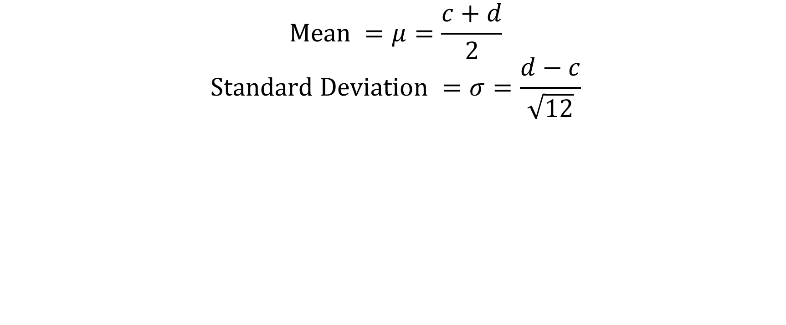
Uniform Distribution
P(x)
1
d-c
0
x
c d

Slide 4
Example
The graph below shows a probability distribution function for temperature in an industrial setting. The temperature is controlled to be between 0 and 5, and every possible temperature is equally likely
P(x)
0.2
0
x
0 1 2 3 4 5
Temperature (degrees Celsius)

Slide 5
Example Continued
Please note that the area under the curve is 1
P(x)
0.2
0
x
0 1 2 3 4 5
Temperature (degrees Celsius)

